Slide 1
Security Smells in Smart Contracts
A static analysis survey on vulnerabilities in Solidity smart contracts
Presenter: Mehmet Demir

Slide 2
This subject is interesting since
+The blockchain technology is new and exciting
+Distributed applications (Dapp) concept is different. Distributed computing is known but applications to be distributed and getting executed in many places at the same time is new
+Nature of smart contract code is different
+Security issues related to smart contracts are different
+They almost always handle money. Risk is high. Attackers have high motivation.
-The subject is new. There is not enough data.
-Limited analysis yet. Findings of the existing studies are limited. Many issues are related to the language and platform.

Slide 3
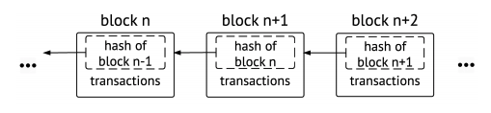
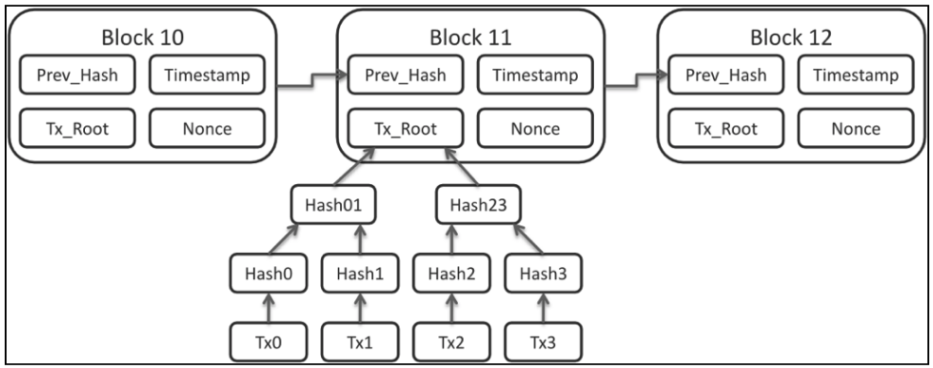
BlockChain

Slide 4
Smart Contract
Involves parties
Computer Code
Added to block chain
Triggered by event(s)
Execute transactions
Get ($5) from (Mehmet)
When Event (Pizza boy delivered)
Give ($4) to PizzaX
Give ($1) to PizzaBoy
If deliveryTime>requestTime + 30 min
Return ($4) to Mehmet
Give ($1) to PizzaBoy
If no delivery in 60 min
Return ($5) to Mehmet

Slide 5
What can be done with smart contracts
Digital asset transfer on the blockchain
Coin creation
Distributed autonomous organizations
Collective investment and seed funding
Wallet representation
Ponzi schemes
Bidding

Slide 6
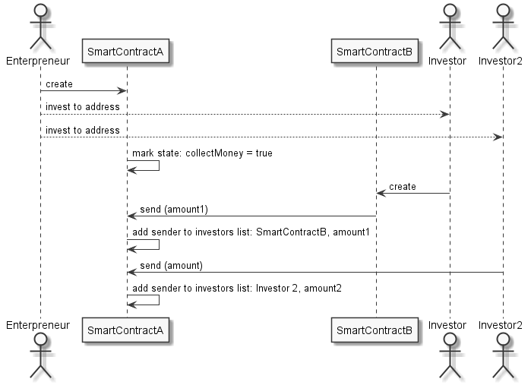
Sample contract

Slide 7
Environment Ethereum- Solidity
Develop the contract
Add the contract to the blockchain
Send money to the contract *
Invoke methods *
with “gas”
Terminate, finalize, suicide

Slide 8
Smells ..
This study
defines the smells and explains them
classifies the smells
lists types and impact of security issues
explains why it is important to have code analysis of smart contracts
emphasize the difference between classical programming and blockchain contracts.

Slide 9
Why is it important to identify vulnerabilities in smart contracts
Conflict of interest between who writes and who execute the applications
Once they are deployed, there is no way for them to be modified.
No way to fix bugs
Risks money, mostly about money, resulting in loss of money
An innocent issue as mistyped variable, can become a vulnerability to trap money in production.
Hackers can read your code, understand the logic. Find vulnerabilities and exploit them.
If you have an error, they can do what it takes to take advantage of it.
Smart contract related incidents are 22% of all blockchain incidents.
Static analysis flags 45% of the existing contracts as vulnerable.

Slide 10
Impact of vulnerabilities
Disabled contract
A contract that can not function due a bug in code or a resulting contract state
Locked money
Reputation

Slide 11
Category 1) Dependence on environment
Transaction ordering dependence
The order of two transactions or interaction to one contract is a factor in outcome
Timestamp dependence
The timestamp is used as an event triggering an outcome
Using block-hash as random number
There is a need for a random number

Slide 12
Category 2) Design and deployment issues
Gas Limit and Loops
Indeterministic loops
Malicious libraries
Calling a library that may have vulnerabilities
Using inline assembly (next slide)
Can not recognize and know what is accomplished in the native code
Compiler version not fixed
Old vs new version of compilers act differently
pragma solidity ^0.4.19; // bad: 0.4.19 and above
pragma solidity 0.4.19; // good: 0.4.19 only

Slide 13
Assembly
function rot13Encrypt (string text) public {
uint256 length = bytes(text).length;
for (var i = 0; i < length; i++) {
byte char = bytes(text)[i];
//inline assembly to modify the string
assembly {
char := byte(0,char) // get the first byte
if and(gt(char,0x6D), lt(char,0x7B)) // if the character is in [n,z], i.e. wrapping.
{ char:= sub(0x60, sub(0x7A,char)) } // subtract from the ascii number a by the difference char is from z.
if iszero(eq(char, 0x20)) // ignore spaces
{mstore8(add(add(text,0x20), mul(i,1)), add(char,13))} // add 13 to char.
}
}
emit Result(text);
}
https://github.com/sigp/solidity-security-blog/blob/master/README.md

Slide 14
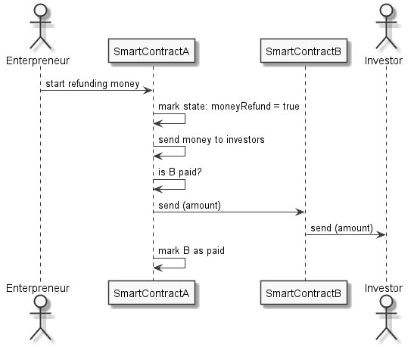
Category 3) Control of execution and reentrancy

Slide 15
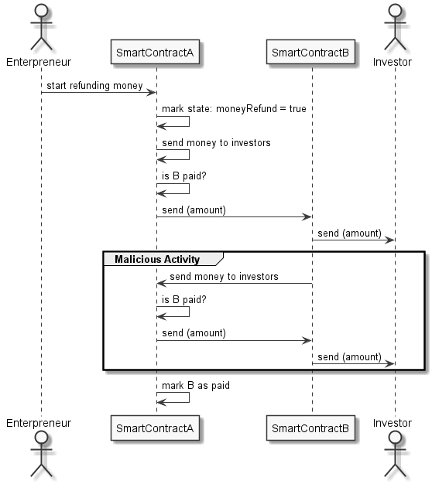
Reentrancy cont..

Slide 16
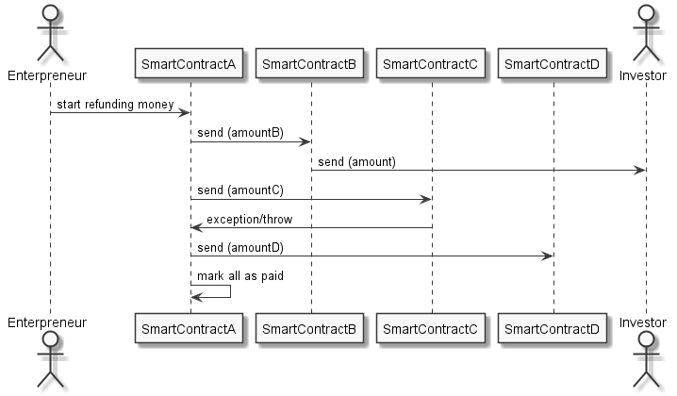
Category 4) DoS by misuse of trust
Exception disorder
Unexpected throw - DoS
Unexpected revert - DoS
DoS with Block Gas Limit
Unchecked external call

Slide 17
Category 5) Unsafe external interaction
Use of tx.origin
vs msg.sender
Send instead of transfer
addr.send(42 ether); // bad
if (!addr.send(42 ether)) revert; // better
addr.transfer(42 ether); // good
Gasless send
Not enough gas left to send money
Using Self destruct
Termination, cleanup, other contract’s dependency
Using throw, revert, assert, require (next slide)
http://orbilu.uni.lu/bitstream/10993/35862/1/smartcheck-paper.pdf

Slide 18
Return, throw, revert, assert, require
contract HasAnOwner { address owner; function useSuperPowers(){ if (msg.sender != owner) { throw; } // do something only the owner should be allowed to do } }
if(msg.sender != owner) { revert(); } // new, like throw, forced rollback
assert(msg.sender == owner); // forced rollback, assertive message
require(msg.sender == owner); // forced rollback, highly readable, kind message
https://medium.com/blockchannel/the-use-of-revert-assert-and-require-in-solidity-and-the-new-revert-opcode-in-the-evm-1a3a7990e06e

Slide 19
Category 6) Vulnerable coding practices
Balance inequality
if (this.balance == 42 ether) // bad
if (this.balance >= 42 ether) // good
Redundant fallback function
Typographical error
+= vs =+
Unchecked math
Overflow, Underflow, Integer division
Unsafe type inference
for (var i = 0; i < array.length; i++) // uint8 max=256
for (uint256 i = 0; i < array.length; i++)
Implicit visibility level
Nothing is private
Address hardcoding and sending
Array length manipulation
anArray.length--; // .. Underflow risk
A setter method that transfer power to the caller
.setOwner(address)
http://orbilu.uni.lu/bitstream/10993/35862/1/smartcheck-paper.pdf

Slide 20
Questions?
-SmartCheck : Static Analysis of Ethereum Smart Contracts http://orbilu.uni.lu/bitstream/10993/35862/1/smartcheck-paper.pdf
-Securify: Practical Security Analysis of Smart Contracts https://arxiv.org/pdf/1806.01143.pdf
-Rethinking Blockchain Security: Position Paper https://arxiv.org/abs/1806.04358
-ContractFuzzer:FuzzingSmartContracts forVulnerabilityDetection https://arxiv.org/ftp/arxiv/papers/1807/1807.03932.pdf
-Making Smart Contracts Smarter – Oyente platform https://eprint.iacr.org/2016/633.pdf
-Smart Contracts Vulnerabilities:A Call for Blockchain Software Engineering
https://ieeexplore.ieee.org/document/8327567
-Empirical Vulnerability Analysis of Automated Smart Contracts Security Testing on Blockchains https://arxiv.org/abs/1809.02702
-Mythril Platform whitepaper https://mythril.ai/files/whitepaper.pdf
A total of 30 resources..
Contact: Mehmet.Demir@Ryerson.ca

